Slide 1
Group Project – Default Team
Kings College London
7CCSMGPR
Module Tutor – Dr. Laurent Tratt
Alain Doebeli
Christakis Vasiliou
Ignacio Dominguez Garcia-Guijas
James Kayongo
Konstantinos Oikonomou
Nikolaos Rizos

Slide 2
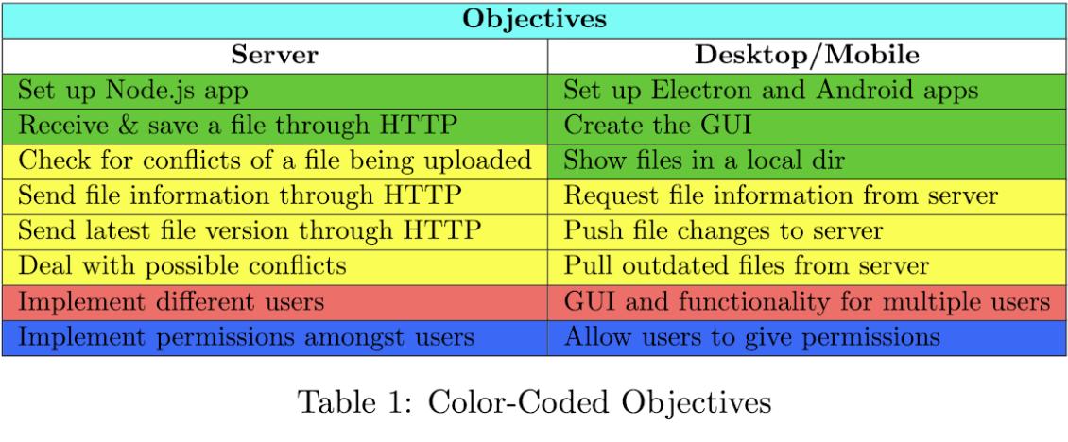
Project Objectives
Initial
Subsequent
Optional
Quality of Life

Slide 3
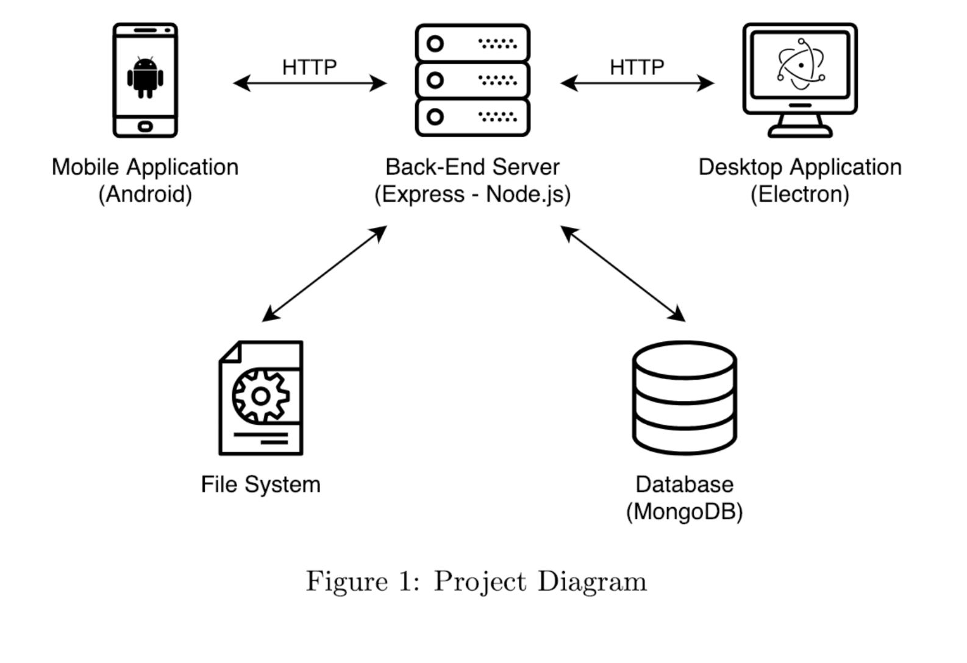
Proposed Architecture Diagram

Slide 4
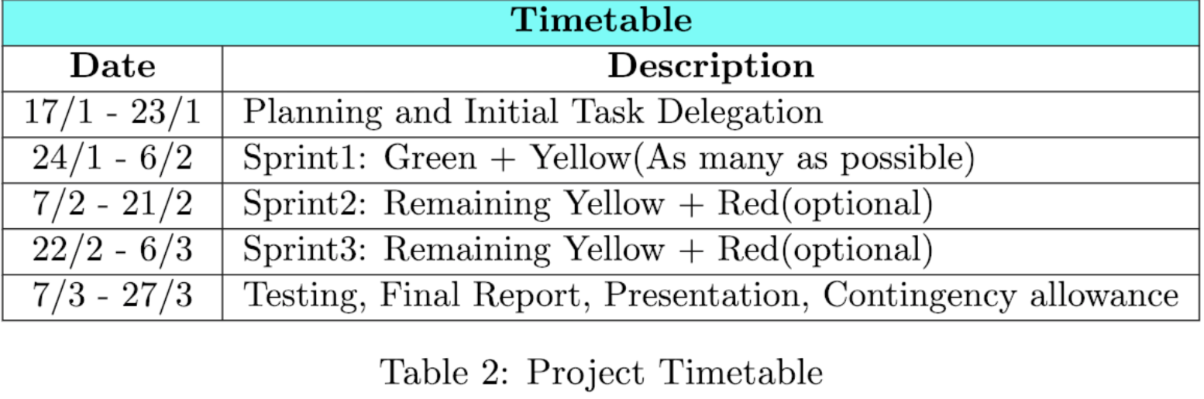
Project Methodology - Schedule
Agile – Scrum
2 Week Sprints
Split in Groups of 2
Sprint Review
Every team member will work on every part
Peer Assessment:
Points split equally to every member
Points deducted in extreme cases and only after team meeting
Conflicts discussed in weekly team meeting

Slide 5

Demonstration

Slide 6

Questions ???

